Slide 1
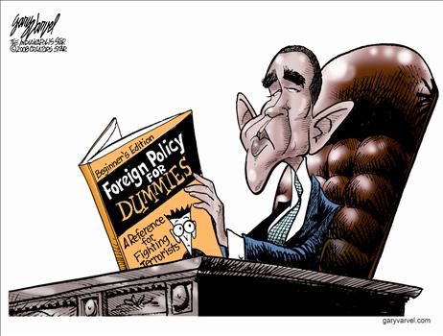
Foreign Policies
By; Joyce Pegler, Sarah Lembo, Keyur Patel, Brian Gianforte, Sean Buechele, and Zack Sheehan

Slide 2
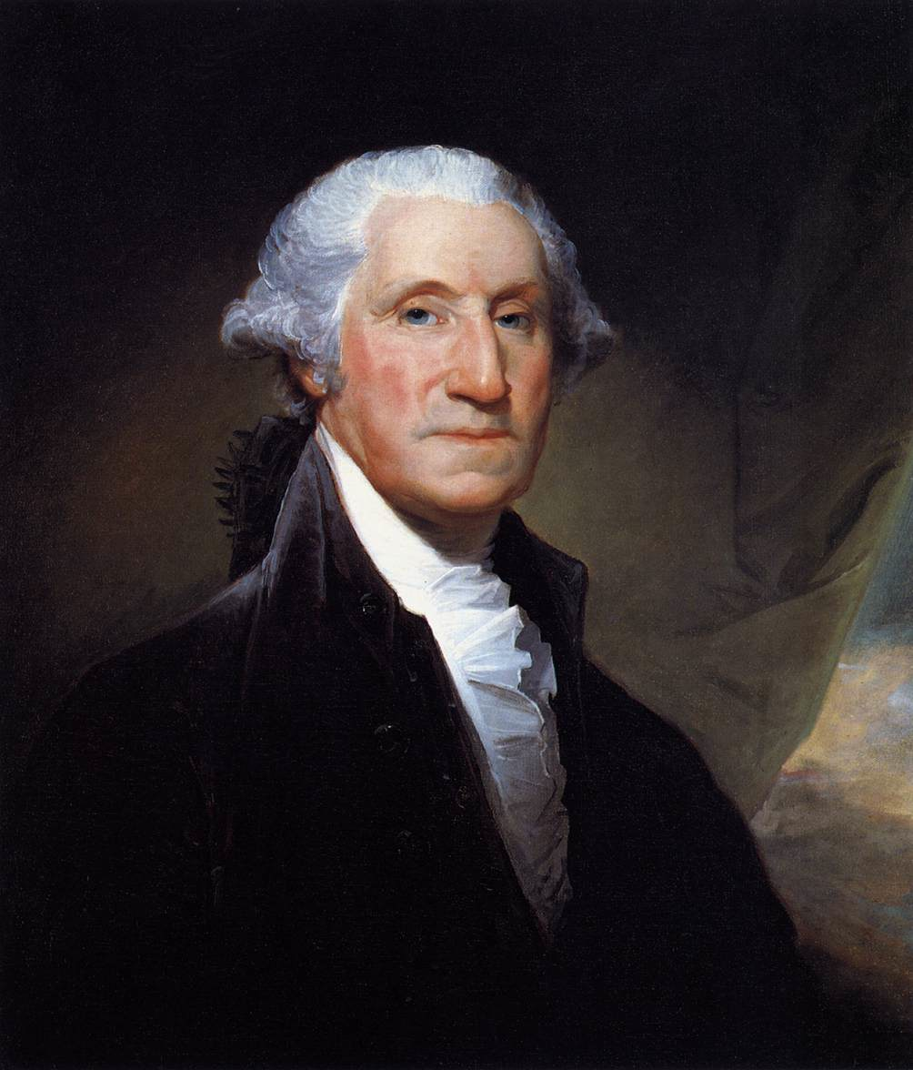
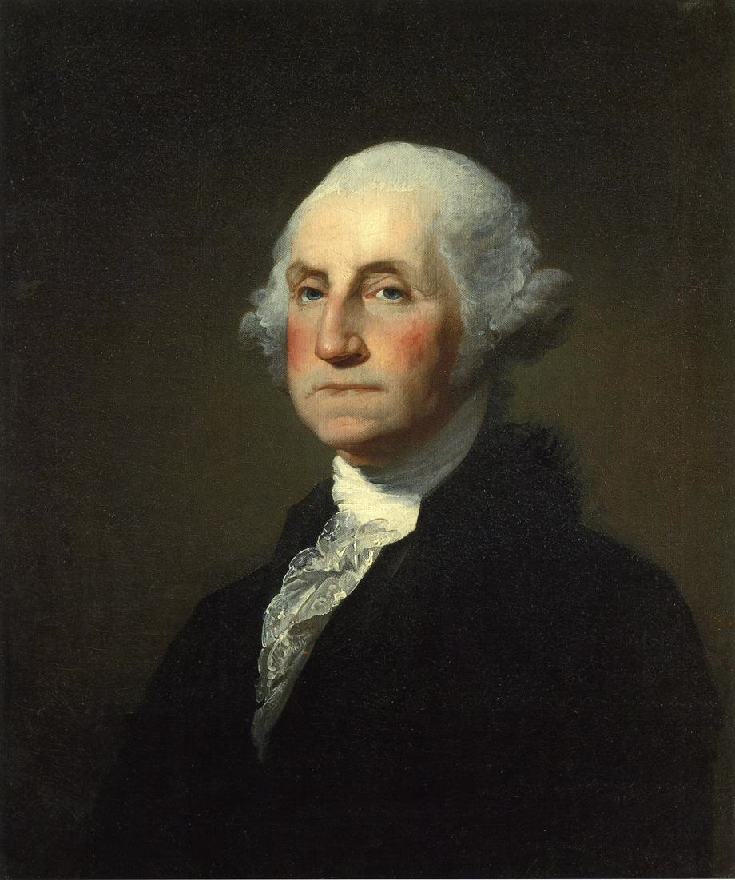
George Washington

Slide 3
Neutrality and No Foreign Entanglements
Washington understood that the United States was too young, had too little money, had too many domestic issues, and had too small a military to actively engage in a strident foreign policy.
No aid to the French during the French Revolution.

Slide 4
Farewell Address
Warned against the danger of:
Political parties
"The alternate domination of one faction over another, sharpened by the spirit of revenge natural to party dissention, which in different ages & countries has perpetrated the most horrid enormities, is itself a frightful despotism. But this leads at length to a more formal and permanent despotism. The disorders & miseries, which result, gradually incline the minds of men to seek security & repose in the absolute power of an Individual: and sooner or later the chief of some prevailing faction more able or more fortunate than his competitors, turns this disposition to the purposes of his own elevation, on the ruins of Public Liberty.”
Foreign alliances
“The great rule of conduct for us in regard to foreign nations is, in extending our commercial relations to have with them as little political connection as possible. So far as we have already formed engagements let them be fulfilled with perfect good faith. Here let us stop."

Slide 5
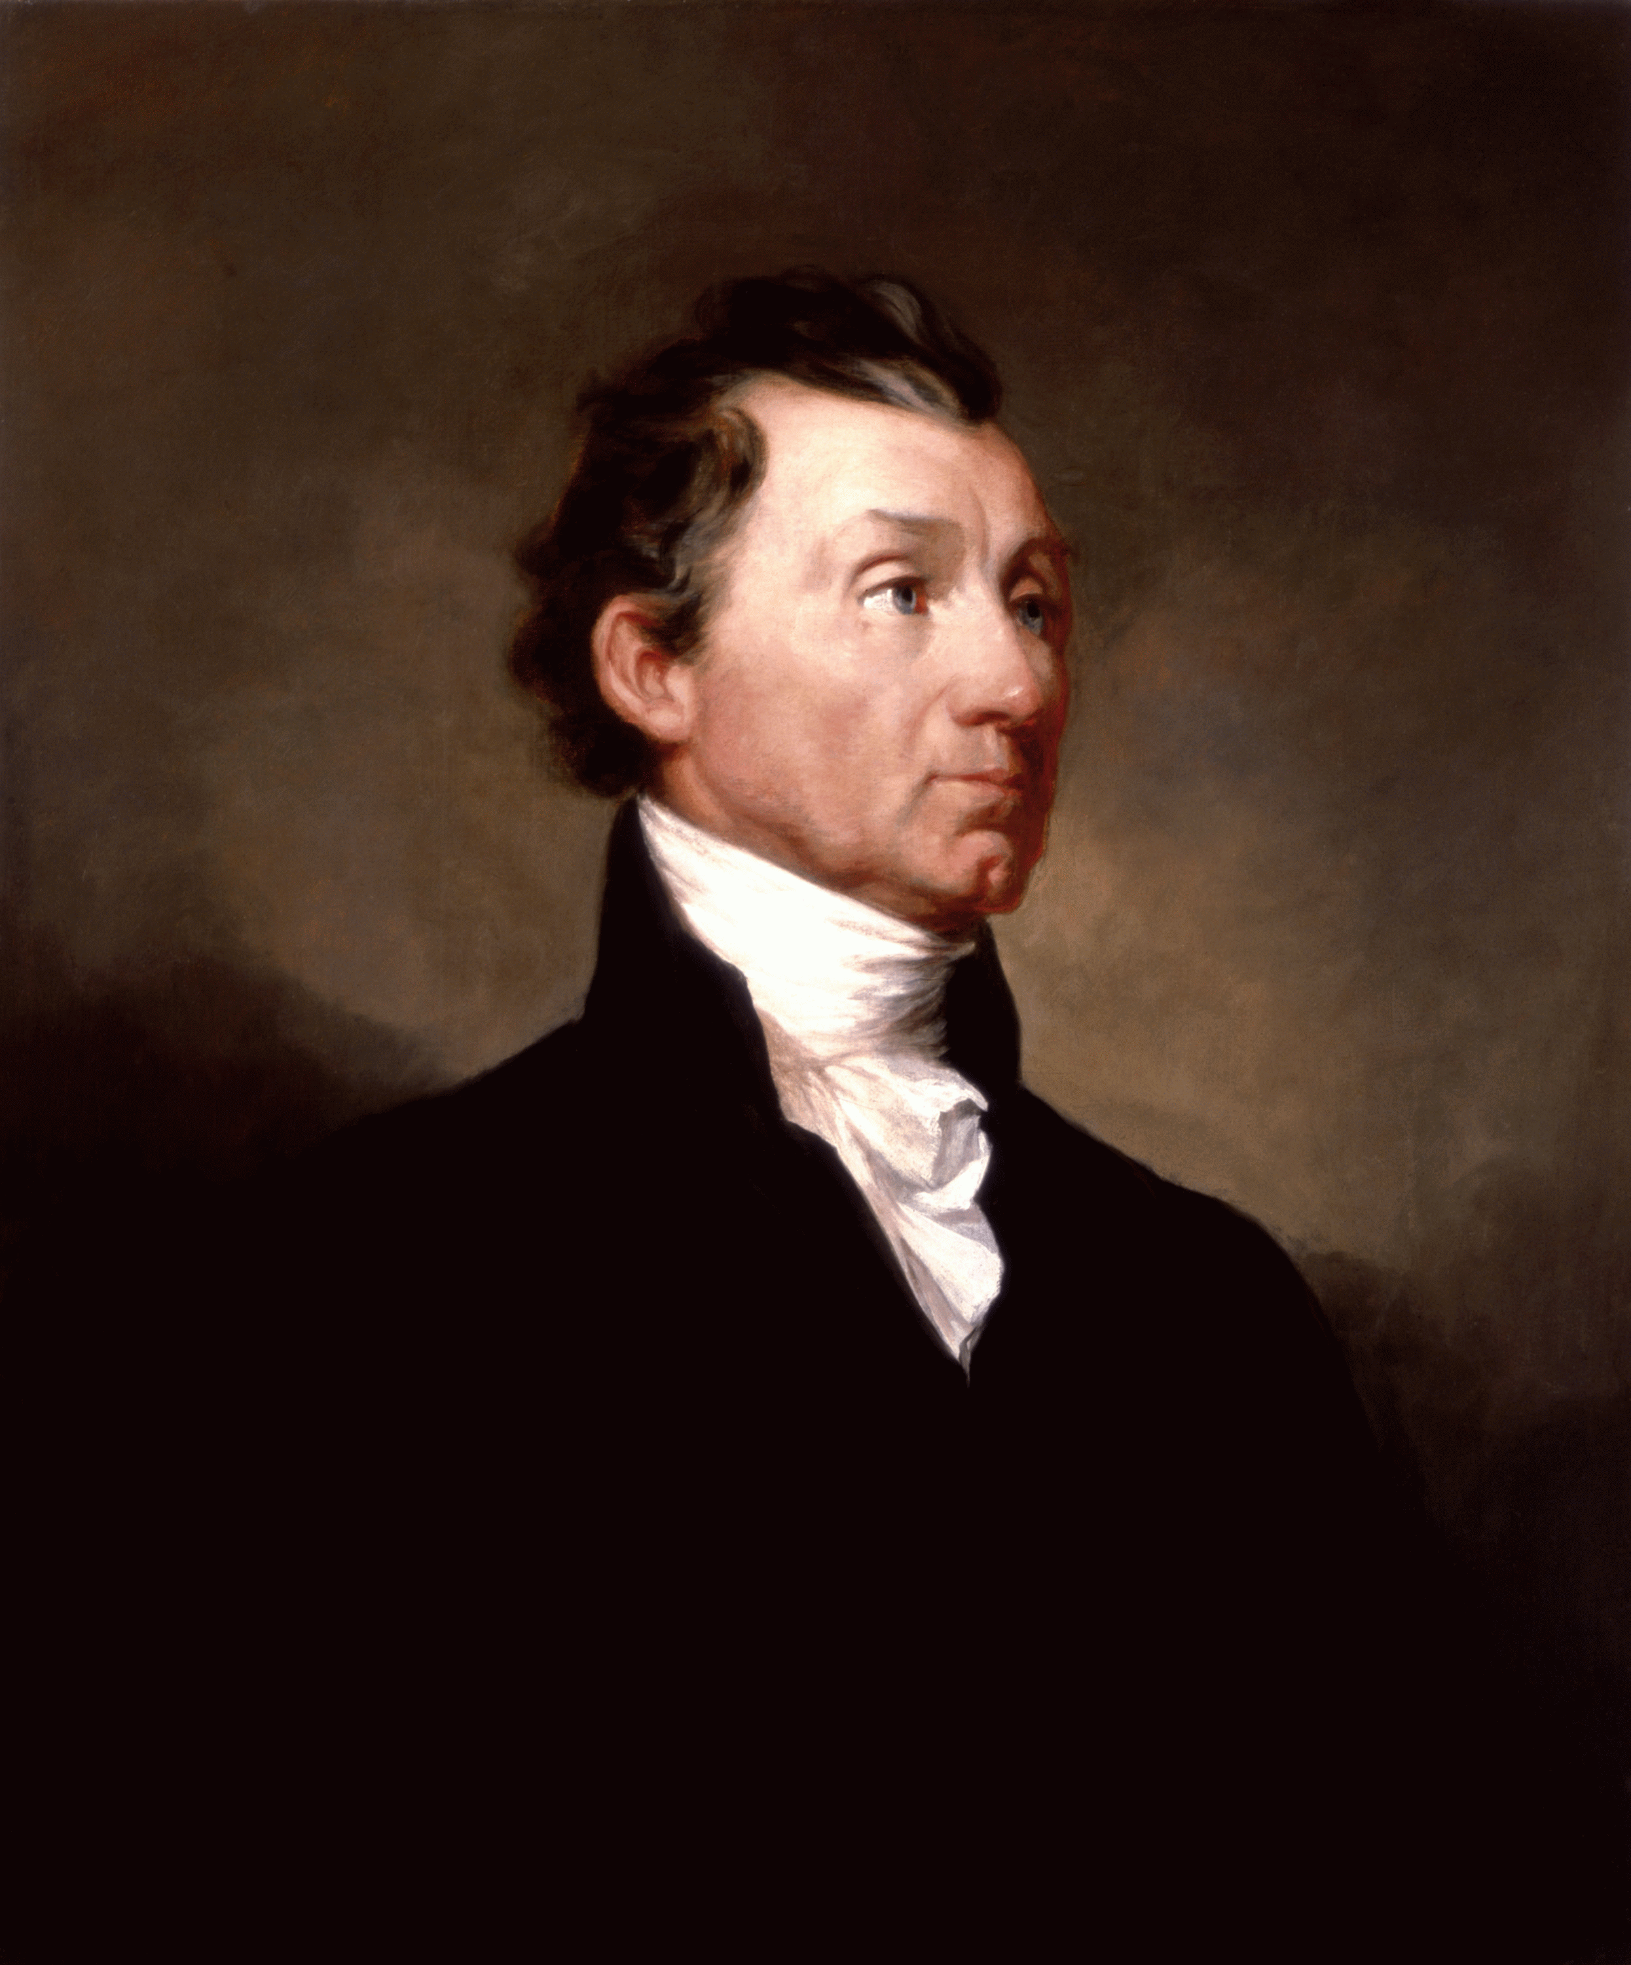
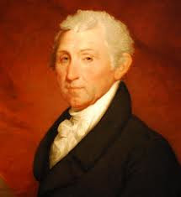
James Monroe (1817-1825)

Slide 6
James Monroe
James Monroe set the precedent for future presidents to come with his foreign policy. His foreign policy was aggressive and he wished to assert America’s independence over the powers of Europe. He showed his aggression in his Monroe Doctrine.

Slide 7
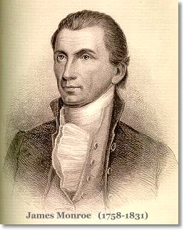
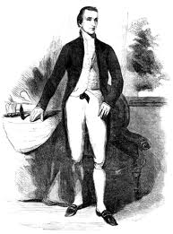
James Monroe continued
There are three parts to his doctrine:
The US would stay neutral with European affairs.
The US would not allow recolonization of any country by its former European master.
Finally, European powers should no longer consider the Western Hemisphere open to colonization.

Slide 8
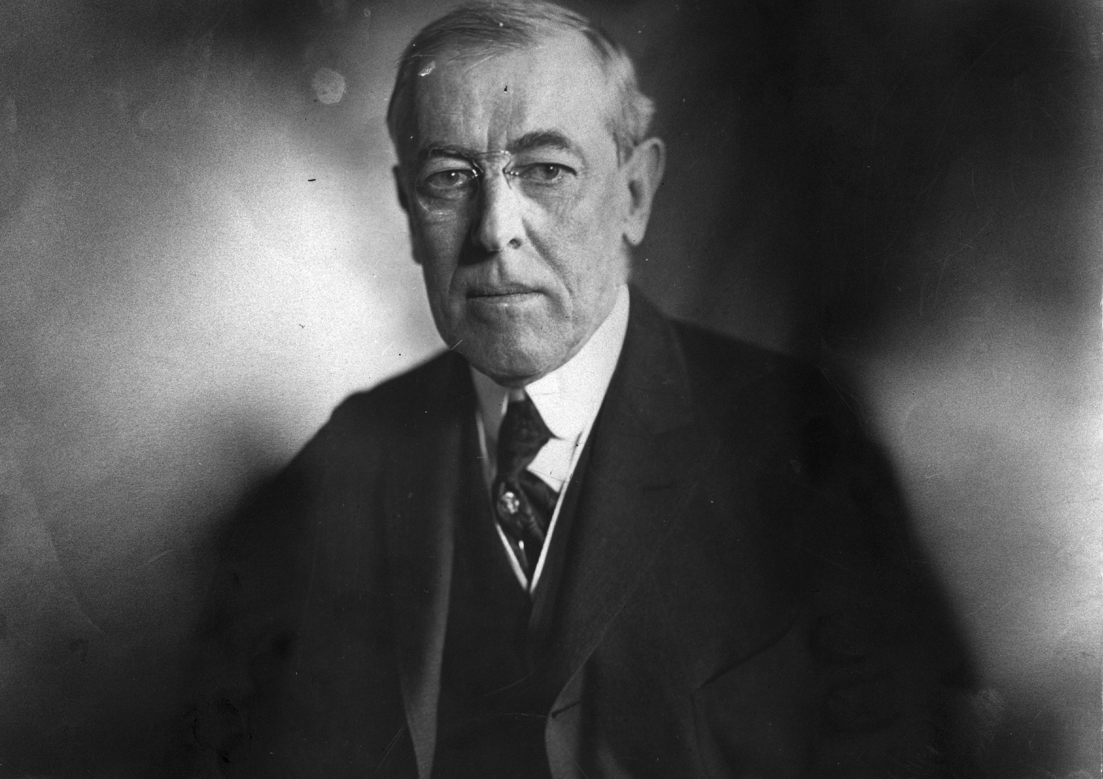
# Woodrow Wilson (1913-1921)

Slide 9
Foreign Policy - Wilson
President
following
age
of
imperialism
Rids the USA of his predecessor’s imperialism
Encourages Moral Diplomacy
Little success to resolve issues in Latin America, which was a main imperialized area

Slide 10
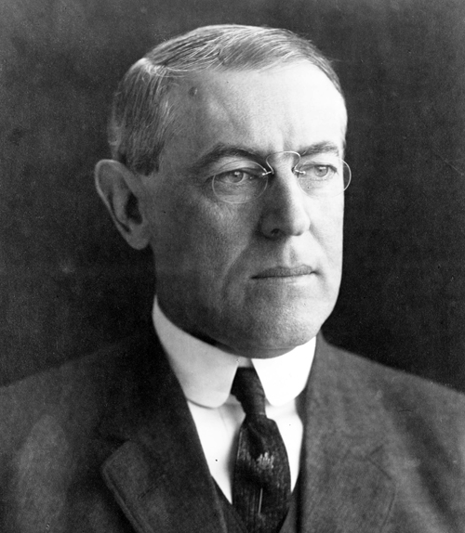
Foreign Policy - Wilson
President
during
World
War
I
Started WWI using Washington’s idea of neutrality
Transitioned to “Peace Without Victory”
Joined WWI in 1917

Slide 11
Foreign Policy - Wilson
Wilson proposes his14 points
League of Nations
US does not sign Treaty of Versailles
US
is
involved
in
World
War
I

Slide 12
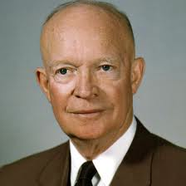
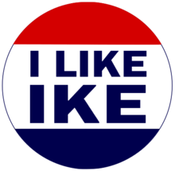
Dwight D. Eisenhower (1953-1961)

Slide 13
Dwight D. Eisenhower
Served as a 5-star general in the Army for World War II, responsible for planning invasions of occupied France and Germany
Ran his presidential campaign in 1952 as a Republican and vowed to fight “Communism, Korea and corruption”
Used the threat of nuclear warfare to end conflicts in Korea and China
U-2 incident stalled peace meetings with the USSR during his presidency
Attempted to start “Atoms for Peace” campaign that encouraged peaceful uses for nuclear materials such as generating power

Slide 14
Dwight D. Eisenhower
Efforts such as these were not welcomed in Russia, and since it was believed that their supply had been amassed to be larger than that of America’s
First to adopt ‘domino theory’ for areas in southeast Asia and central America that would later be used to justify conflict in Vietnam; stated that if these small nations fell to Communism, larger nations, and eventually the US, would fall after it
Used CIA resources to dispose of people in poor nations that would be susceptible to Communist revolutions in Iran, Guatemala, Congo
Also helped plan out the Bay of Pigs invasion which Kennedy would eventually carry out
Was encouraged by many advisors to carry out an atomic attack on China which he refused

Slide 15
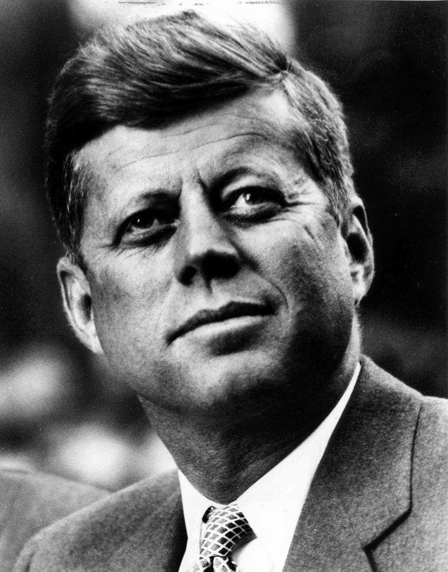
John F. Kennedy (1961-1963)

Slide 16
John F. Kennedy
Berlin Crisis of 1961
Last major politico-military European incident of the Cold War
Occupational status of Berlin
Cuban Missile Crisis
October 14 – 28, 1962
Regarded as the moment in which the Cold War came closest to turning into a nuclear conflict
Flexible response
Calls for mutual deterrence at strategic, tactical, and conventional levels

Slide 17
John F. Kennedy
U.S. Arms Control and Disarmament Agency (ACDA)
Formulated, advocated, negotiated, implemented and verified effective arms control and disarmament policies, strategies, and agreements
Peace Corps
Established March 1, 1961
Presently, over 210,000 Americans joined the Peace Corps and served in 139 countries

